Slide 1

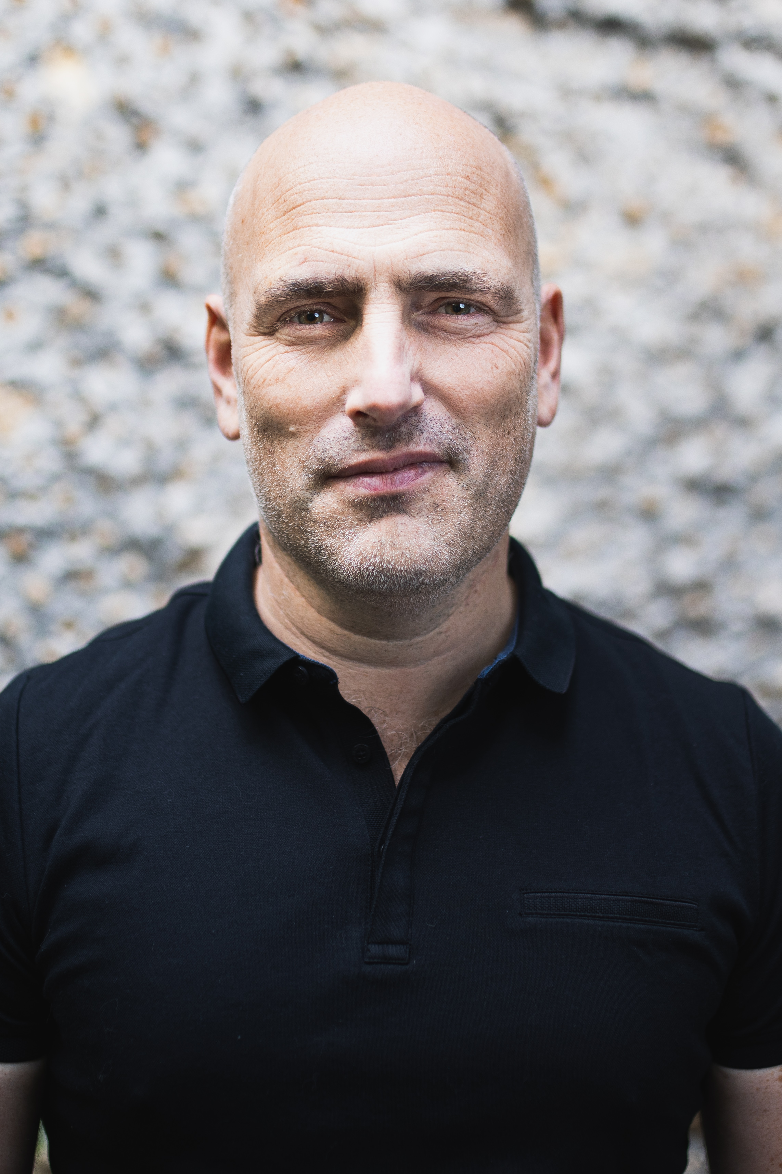
BIOGRAPHY
OLIVIER PIEPSZ
An aerodynamic engineer by training, graduated from the Ecole Polytechnique de Bruxelles, Olivier gone to the Von Karman Institute under NATO and then continued his studies in Toulouse at Supaéro, specializing in the space field.
After two and a half year at MIT (Massachusetts Institute of Technology) where he carried out basic research activities on active turbulence control, he returned to Europe where he took on at Verhaert, technical responsibility for the Agency's satellite. European Space, PROBA, phase 0.
Spotted by a Dassault Aviation executive, he joined the group and its Defense department in 1998. He started responsible for the after-sales service for planes in services in South America, then he tooks part in the Mirage2000 sales campaign in Chile, then he was responsible for the Rafale Netherlands campaign against the JSF and was in charge of the Poland offer finalization. In 2002, he was entrusted with the management of the Rafale Switzerland campaign, which he lead for almost 10 years. Olivier also participated in the development of the European combat drone project nEUROn and successfully negotiated the entry of Switzerland into the program.
In 2011, at the request of Safran, Olivier took the position of Senior Vice-President for Latin America, then Africa was attached to his zone. After the 2017 Paris Air Show, his scope of responsibility was expanded by entrusting it with the United States, Canada and the Pacific zone (Japan, Australia and New Zealand).
At the start of 2020, Olivier was entrusted with an area bringing together the major world aircraft manufacturers: the Americas and Continental Europe, which groups together around Russia, European countries that are not members of the Union.
Within GIFAS, as chairman of the working group for the Americas, he also led initiatives in favor of SMEs, mid-cap companies and their access to innovation and participated in discussions on the consolidation of the French supply chain internationally.
In fields as varied as satellites, surveillance drones, the most advanced biometric solutions, Rafale combat aircraft, airports, passports, cooperations with universities and start-ups, implementation and negotiation new industrial sites, breakthrough projects such as the Solar Impulse adventure by B. Piccard or the small Q @ ts launcher by ArianeGroup, in bilateral approaches such as the establishment of the Franco-Mexican Strategic Council, the co-organization France-Brazil seminars for L. Fabius, the "missions for growth" of the former European Commissioner A. Tajani, Olivier showed that he was able to understand the different aspects of complex issues combining politics and high technology with a strong conviction always turned towards Europe, guarantor of peace and development.
In January 2020, he creates the company Prométhée Earth Intelligence of which he takes the presidency.
Tour Montparnasse
33 av du Maine – 75015 Paris

